Slide 1
Data Modeling Using the Entity-Relationship (ER) Model
:
Copyright © 2004 Pearson Education, Inc.

Slide 2
Chapter Outline
Example Database Application (COMPANY)
ER Model Concepts
  Entities and Attributes
  Entity Types, Value Sets, and Key Attributes
  Relationships and Relationship Types
  Weak Entity Types
  Roles and Attributes in Relationship Types
ER Diagrams - Notation
ER Diagram for COMPANY Schema
Alternative Notations – UML class diagrams, others
Chapter 3-<number>

Slide 3
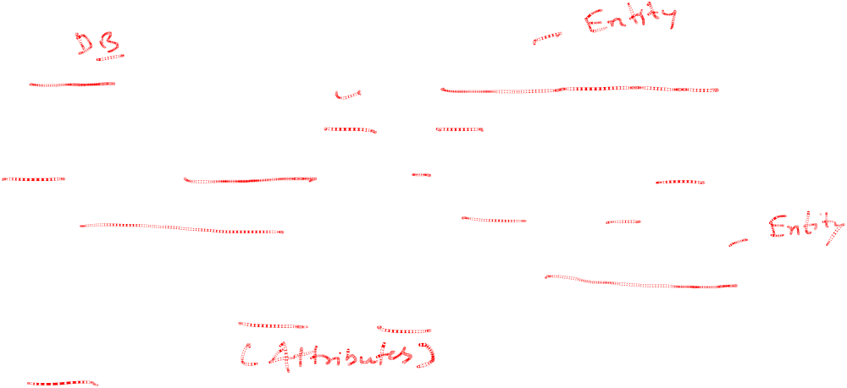
Example COMPANY Database
Requirements of the Company (oversimplified for illustrative purposes)
  The company is organized into DEPARTMENTs. Each department has a name, number and an employee who manages the department. We keep track of the start date of the department manager.
  Each department controls a number of PROJECTs. Each project has a name, number and is located at a single location.
Chapter 3-<number>

Slide 4
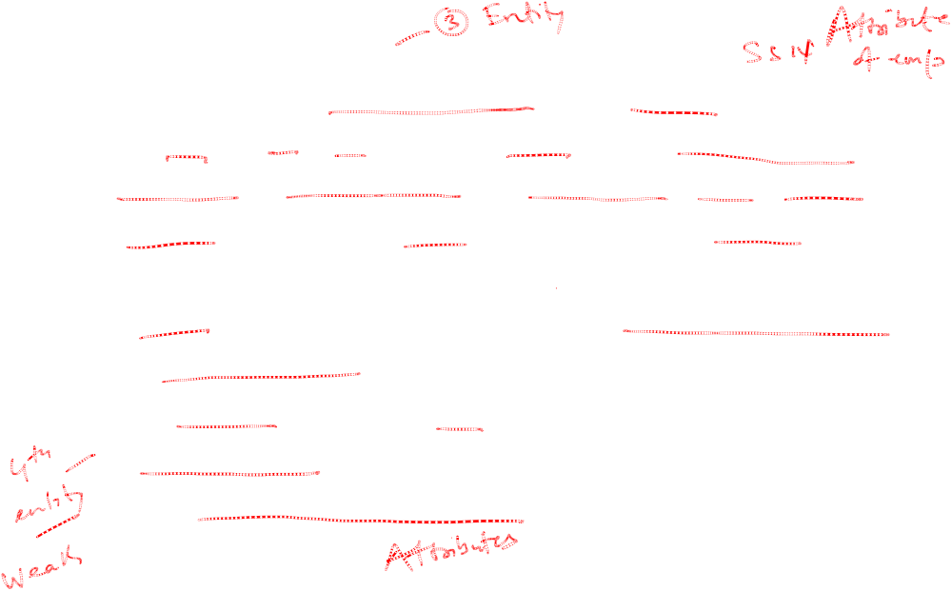
Example COMPANY Database (Cont.)
  We store each EMPLOYEE’s social security number, address, salary, sex, and birthdate. Each employee works for one department but may work on several projects. We keep track of the number of hours per week that an employee currently works on each project. We also keep track of the direct supervisor of each employee.
  Each employee may have a number of DEPENDENTs. For each dependent, we keep track of their name, sex, birthdate, and relationship to employee.
Chapter 3-<number>

Slide 5
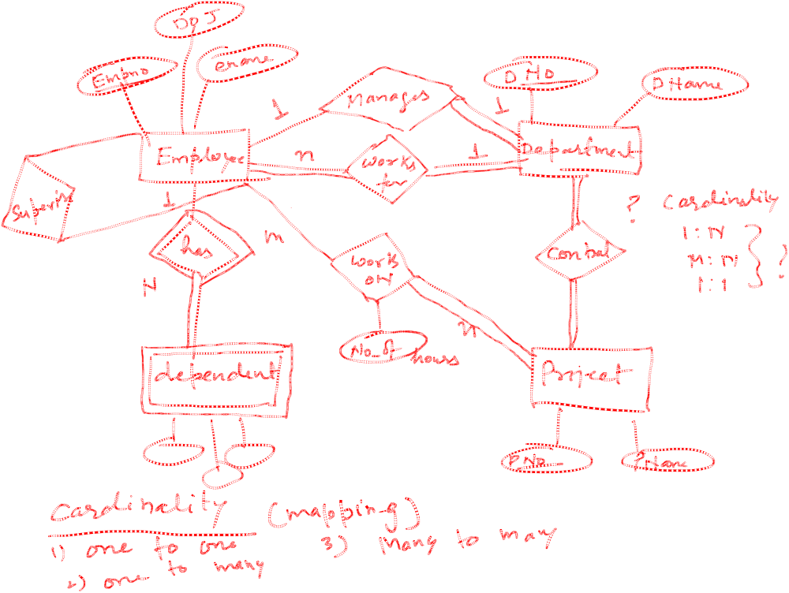


Slide 6
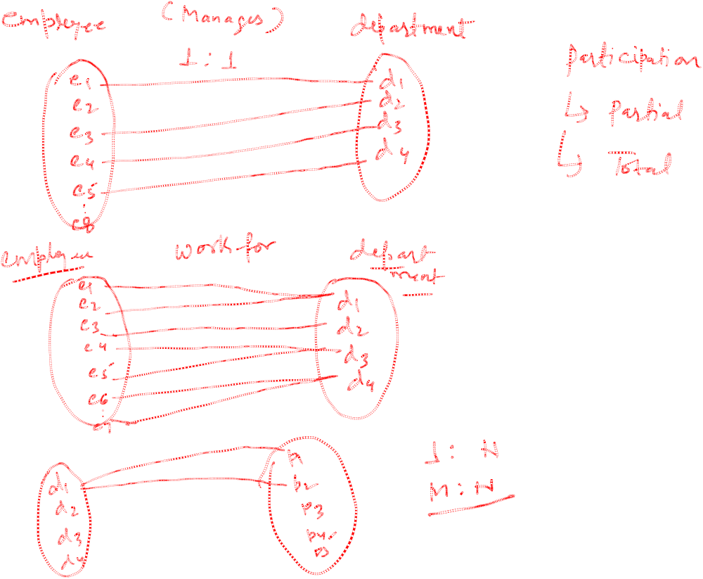

Slide 7
ER Model Concepts
Entities and Attributes
  Entities are specific objects or things in the mini-world that are represented in the database. For example the EMPLOYEE John Smith, the Research DEPARTMENT, the ProductX PROJECT
  Attributes are properties used to describe an entity. For example an EMPLOYEE entity may have a Name, SSN, Address, Sex, BirthDate
  A specific entity will have a value for each of its attributes. For example a specific employee entity may have Name='John Smith', SSN='123456789', Address ='731, Fondren, Houston, TX', Sex='M', BirthDate='09-JAN-55‘
  Each attribute has a value set (or data type) associated with it – e.g. integer, string, subrange, enumerated type, …
Chapter 3-<number>

Slide 8
Types of Attributes (1)
Simple
  Each entity has a single atomic value for the attribute. For example, SSN or Sex.
Composite
  The attribute may be composed of several components. For example, Address (Apt#, House#, Street, City, State, ZipCode, Country) or Name (FirstName, MiddleName, LastName). Composition may form a hierarchy where some components are themselves composite.
Multi-valued
  An entity may have multiple values for that attribute. For example, Color of a CAR or PreviousDegrees of a STUDENT. Denoted as {Color} or {PreviousDegrees}.
Chapter 3-<number>

Slide 9
Types of Attributes (2)
In general, composite and multi-valued attributes may be nested arbitrarily to any number of levels although this is rare. For example, PreviousDegrees of a STUDENT is a composite multi-valued attribute denoted by {PreviousDegrees (College, Year, Degree, Field)}.
Chapter 3-<number>

Slide 10
Entity Types and Key Attributes
Entities with the same basic attributes are grouped or typed into an entity type. For example, the EMPLOYEE entity type or the PROJECT entity type.
An attribute of an entity type for which each entity must have a unique value is called a key attribute of the entity type. For example, SSN of EMPLOYEE.
A key attribute may be composite. For example, VehicleTagNumber is a key of the CAR entity type with components (Number, State).
An entity type may have more than one key. For example, the CAR entity type may have two keys:
  VehicleIdentificationNumber (popularly called VIN) and
  VehicleTagNumber (Number, State), also known as license_plate number.
Chapter 3-<number>

Slide 11
ENTITY SET corresponding to the
ENTITY TYPE CAR
CAR
Registration(RegistrationNumber, State), VehicleID, Make, Model, Year, (Color)
car₁
((ABC 123, TEXAS), TK629, Ford Mustang, convertible, 1999, (red, black))
car₂
((ABC 123, NEW YORK), WP9872, Nissan 300ZX, 2-door, 2002, (blue))
car₃
((VSY 720, TEXAS), TD729, Buick LeSabre, 4-door, 2003, (white, blue))
.
.
.
Chapter 3-<number>

Slide 12
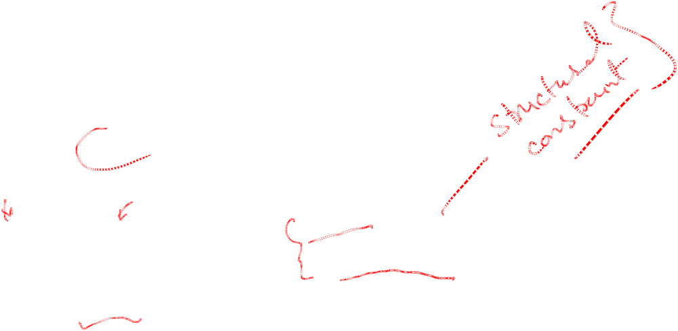
SUMMARY OF ER-DIAGRAM
NOTATION FOR ER SCHEMAS
Symbol
Meaning
ENTITY TYPE
WEAK ENTITY TYPE
RELATIONSHIP TYPE
IDENTIFYING RELATIONSHIP TYPE
ATTRIBUTE
KEY ATTRIBUTE
MULTIVALUED ATTRIBUTE
COMPOSITE ATTRIBUTE
DERIVED ATTRIBUTE
TOTAL PARTICIPATION OF E₂ IN R
CARDINALITY RATIO 1:N FOR E₁:E₂ IN R
STRUCTURAL CONSTRAINT (min, max) ON PARTICIPATION OF E IN R
E₁
R
E₂
E₁
R
N
E₂
R
(min,max)
E
Chapter 3-<number>

Slide 13
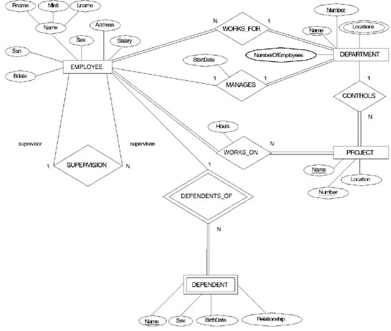
ER DIAGRAM – Entity Types are:
EMPLOYEE, DEPARTMENT, PROJECT, DEPENDENT
Chapter 3-<number>

Slide 14
Relationships and Relationship Types (1)
A relationship relates two or more distinct entities with a specific meaning. For example, EMPLOYEE John Smith works on the ProductX PROJECT or EMPLOYEE Franklin Wong manages the Research DEPARTMENT.
Relationships of the same type are grouped or typed into a relationship type. For example, the WORKS_ON relationship type in which EMPLOYEEs and PROJECTs participate, or the MANAGES relationship type in which EMPLOYEEs and DEPARTMENTs participate.
The degree of a relationship type is the number of participating entity types. Both MANAGES and WORKS_ON are binary relationships.
Chapter 3-<number>

Slide 15
Example relationship instances of the WORKS_FOR relationship between EMPLOYEE and DEPARTMENT
EMPLOYEE
WORKS_FOR
DEPARTMENT
e_{1 }
e_{2 }
e_{3 }
e_{4 }
e_{5 }
e_{6 }
e_{7 }
r₁
r₂
r₃
r₄
r₅
r₆
r₇
● d₁
● d₂
● d₃
Chapter 3-<number>

Slide 16
Example relationship instances of the WORKS_ON relationship between EMPLOYEE and PROJECT
e_{1 }
e_{2 }
e_{3 }
e_{4 }
e_{5 }
e_{6 }
e_{7 }
r₉
r₁
r₂
r₃
r₄
r₅
r₆
r₇
● p₁
● p₂
● p₃
r₈
Chapter 3-<number>

Slide 17
Relationships and Relationship Types (2)
More than one relationship type can exist with the same participating entity types. For example, MANAGES and WORKS_FOR are distinct relationships between EMPLOYEE and DEPARTMENT, but with different meanings and different relationship instances.
Chapter 3-<number>

Slide 18
ER DIAGRAM – Relationship Types are:
WORKS_FOR, MANAGES, WORKS_ON, CONTROLS,
SUPERVISION, DEPENDENTS_OF
Chapter 3-<number>

Slide 19
Weak Entity Types
An entity that does not have a key attribute
A weak entity must participate in an identifying relationship type with an owner or identifying entity type
Entities are identified by the combination of:
  A partial key of the weak entity type
  The particular entity they are related to in the identifying entity type
Example:
Suppose that a DEPENDENT entity is identified by the dependent’s first name and birhtdate, and the specific EMPLOYEE that the dependent is related to. DEPENDENT is a weak entity type with EMPLOYEE as its identifying entity type via the identifying relationship type DEPENDENT_OF
Chapter 3-<number>

Slide 20
Weak Entity Type is: DEPENDENT
Identifying Relationship is: DEPENDENTS_OF
Chapter 3-<number>

Slide 21
Constraints on Relationships
Constraints on Relationship Types
  ( Also known as ratio constraints )
  Maximum Cardinality
    One-to-one (1:1)
    One-to-many (1:N) or Many-to-one (N:1)
    Many-to-many
  Minimum Cardinality (also called participation constraint or existence dependency constraints)
    zero (optional participation, not existence-dependent)
    one or more (mandatory, existence-dependent)
Chapter 3-<number>

Slide 22
Many-to-one (N:1) RELATIONSHIP
EMPLOYEE
WORKS_FOR
DEPARTMENT
e_{1 }
e_{2 }
e_{3 }
e_{4 }
e_{5 }
e_{6 }
e_{7 }
r₁
r₂
r₃
r₄
r₅
r₆
r₇
● d₁
● d₂
● d₃
Chapter 3-<number>

Slide 23
Many-to-many (M:N) RELATIONSHIP
e_{1 }
e_{2 }
e_{3 }
e_{4 }
e_{5 }
e_{6 }
e_{7 }
r₉
r₁
r₂
r₃
r₄
r₅
r₆
r₇
● p₁
● p₂
● p₃
r₈
Chapter 3-<number>

Slide 24
Relationships and Relationship Types (3)
We can also have a recursive relationship type.
Both participations are same entity type in different roles.
For example, SUPERVISION relationships between EMPLOYEE (in role of supervisor or boss) and (another) EMPLOYEE (in role of subordinate or worker).
In following figure, first role participation labeled with 1 and second role participation labeled with 2.
In ER diagram, need to display role names to distinguish participations.
Chapter 3-<number>

Slide 25
A RECURSIVE RELATIONSHIP
SUPERVISION
EMPLOYEE
SUPERVISION
e_{1 }
e_{2 }
e_{3 }
e_{4 }
e_{5 }
e_{6 }
e_{7 }
r₁
r₂
r₃
r₄
r₅
r₆
2
1
1
2
2
1
2
1
1
2
1
2
© The Benjamin/Cummings Publishing Company, Inc. 1994, Elmasri/Navathe, Fundamentals of Database Systems, Second Edition
Chapter 3-<number>

Slide 26
Recursive Relationship Type is: SUPERVISION
(participation role names are shown)
Chapter 3-<number>

Slide 27
Attributes of Relationship types
A relationship type can have attributes; for example, HoursPerWeek of WORKS_ON; its value for each relationship instance describes the number of hours per week that an EMPLOYEE works on a PROJECT.
Chapter 3-<number>

Slide 28
Attribute of a Relationship Type is:
Hours of WORKS_ON
Chapter 3-<number>

Slide 29
Structural Constraints – one way to express semantics of relationships
Structural constraints on relationships:
Cardinality ratio (of a binary relationship): 1:1, 1:N, N:1, or M:N
  SHOWN BY PLACING APPROPRIATE NUMBER ON THE LINK.
Participation constraint (on each participating entity type): total (called existence dependency) or partial.
SHOWN BY DOUBLE LINING THE LINK
NOTE: These are easy to specify for Binary Relationship Types.
Chapter 3-<number>

Slide 30
Alternative (min, max) notation for relationship structural constraints:
Specified on each participation of an entity type E in a relationship type R
Specifies that each entity e in E participates in at least min and at most max relationship instances in R
Default(no constraint): min=0, max=n
Must have min≤max, min≥0, max ≥1
Derived from the knowledge of mini-world constraints
Examples:
A department has exactly one manager and an employee can manage at most one department.
  Specify (0,1) for participation of EMPLOYEE in MANAGES
  Specify (1,1) for participation of DEPARTMENT in MANAGES
An employee can work for exactly one department but a department can have any number of employees.
  Specify (1,1) for participation of EMPLOYEE in WORKS_FOR
  Specify (0,n) for participation of DEPARTMENT in WORKS_FOR
Chapter 3-<number>

Slide 31
The (min,max) notation relationship constraints
(0,1)
(1,1)
Employee
Manages
Department
(1,1)
(1,N)
Employee
Department
Works-for
Chapter 3-<number>

Slide 32
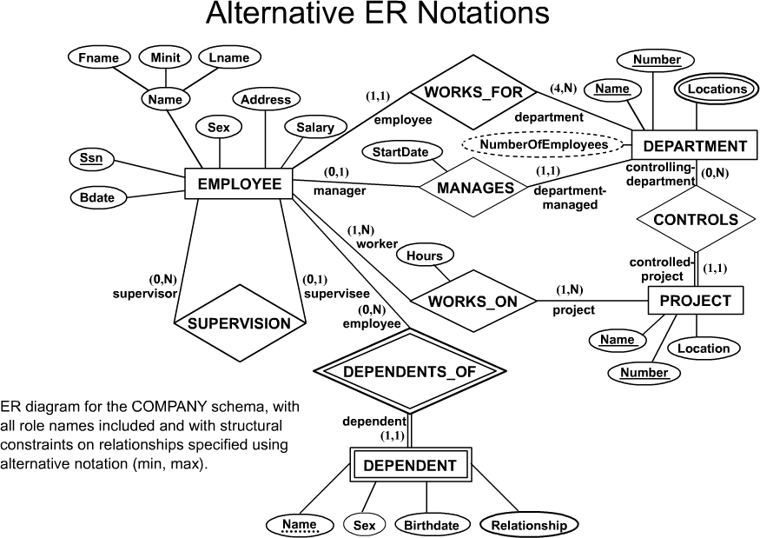
COMPANY ER Schema Diagram using (min, max) notation
Chapter 3-<number>

Slide 33
Relationships of Higher Degree
Relationship types of degree 2 are called binary
Relationship types of degree 3 are called ternary and of degree n are called n-ary
In general, an n-ary relationship is not equivalent to n binary relationships
Higher-order relationships discussed further in Chapter 4
Chapter 3-<number>

Slide 34
Data Modeling Tools
A number of popular tools that cover conceptual modeling and mapping into relational schema design. Examples: ERWin, S- Designer (Enterprise Application Suite), ER- Studio, etc.
POSITIVES: serves as documentation of application requirements, easy user interface - mostly graphics editor support
Chapter 3-<number>

Slide 35
Problems with Current Modeling Tools
DIAGRAMMING
  Poor conceptual meaningful notation.
  To avoid the problem of layout algorithms and aesthetics of diagrams, they prefer boxes and lines and do nothing more than represent (primary-foreign key) relationships among resulting tables.(a few exceptions)
METHODOLGY
  lack of built-in methodology support.
  poor tradeoff analysis or user-driven design preferences.
  poor design verification and suggestions for improvement.
Chapter 3-<number>

Slide 36
Some of the Currently Available Automated Database
Design Tools
COMPANY | TOOL | FUNCTIONALITY
Embarcadero Technologies | ER Studio | Database Modeling in ER and IDEF1X
 | DB Artisan | Database administration and space and security management
Oracle | Developer 2000 and Designer 2000 | Database modeling, application development
Popkin Software | System Architect 2001 | Data modeling, object modeling, process modeling, structured analysis/design
Platinum Technology | Platinum Enterprice Modeling Suite: Erwin, BPWin, Paradigm Plus | Data, process, and business component modeling
Persistence Inc. | Pwertier | Mapping from O-O to relational model
Rational | Rational Rose | Modeling in UML and application generation in C++ and JAVA
Rogue Ware | RW Metro | Mapping from O-O to relational model
Resolution Ltd. | Xcase | Conceptual modeling up to code maintenance
Sybase | Enterprise Application Suite | Data modeling, business logic modeling
Visio | Visio Enterprise | Data modeling, design and reengineering Visual Basic and Visual C++
Chapter 3-<number>

Slide 37
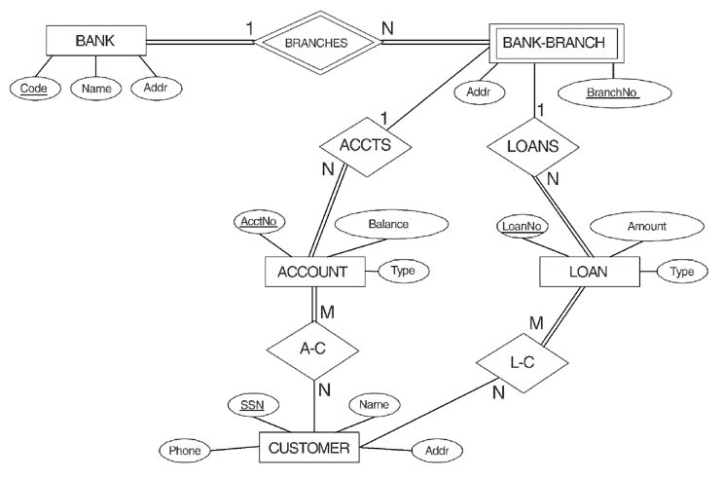
ER DIAGRAM FOR A BANK
DATABASE
© The Benjamin/Cummings Publishing Company, Inc. 1994, Elmasri/Navathe, Fundamentals of Database Systems, Second Edition
Chapter 3-<number>

Slide 38
PROBLEM with ER notation
THE ENTITY RELATIONSHIP MODEL IN ITS ORIGINAL FORM DID NOT SUPPORT THE SPECIALIZATION/ GENERALIZATION ABSTRACTIONS
Chapter 3-<number>

Slide 39
Extended Entity-Relationship (EER) Model
Incorporates Set-subset relationships
Incorporates Specialization/Generalization Hierarchies
NEXT CHAPTER ILLUSTRATES HOW THE ER MODEL CAN BE EXTENDED WITH
- Set-subset relationships and Specialization/Generalization Hierarchies and how to display them in EER diagrams
Chapter 3-<number>

